Slide 1



A Presentation
on
“Online Dairy World”
Guided By- Mrs.Snehal Somvanshi .

Slide 2
Presented By
NNo | Name Name | PRN
1. | Dhruti.Y.Patil | 230343020069
2. | Supriya.S.Bhinge. | 230343020014
3. | Aditya.S.Waikar | 230343020110

Slide 3
Purpose
The project provides an online platform for delivery of online dairy products from Farmers/Sweet dealers(suppliers) to customers at doorsteps.

Slide 4
Goals of Project
Provide online platform for selling dairy products directly to customers
To allow dairy producers-Farmers to expand their business and reach to larger customer.
To allow customers to access wide range of dairy products without physically visiting stores.
To allow customers to check availability ,compared prices, place orders of products at their convenience.

Slide 5
Beneficiaries of the project
This project will be beneficial for the buyers due to better choices , home delivery as well as for sweet dealers and farmers due to increased sales and better customer relationship.

Slide 6
Overview
Online Dairy World- A Web based Application.
Users of Application-
Admin
Buyers
Buyers- search products ,add products to cart, place order.
Admin-Maintains System, add and update suppliers product.

Slide 7
Project Architecture
Used for Used for
User interfacing Server side validations, if needed
Basic data validation Response handling Used for
Business logic Permanent data storage
Database operations Database level validations
Database access using
stored procedures
Technologies used:
HTML,CSS
Java script, jQuery Technologies used:
React JS Spring boot MVC Technologies used:
Json ,Bootstrap MySQL
Front end layer
Server layer
Database layer

Slide 8
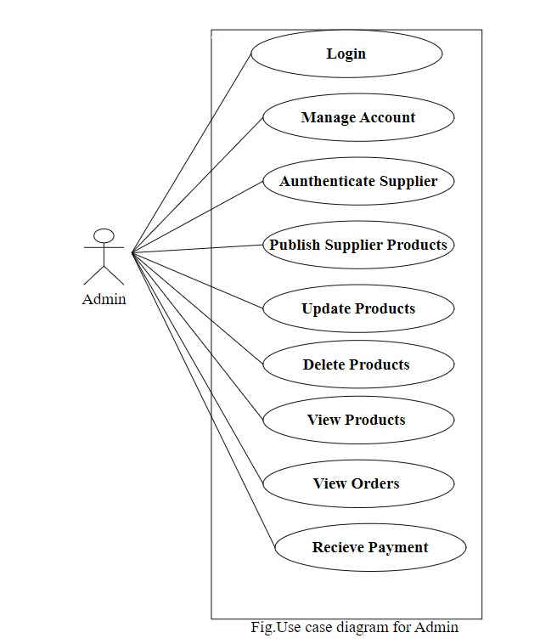
Use Case Diagram
1.Admin

Slide 9
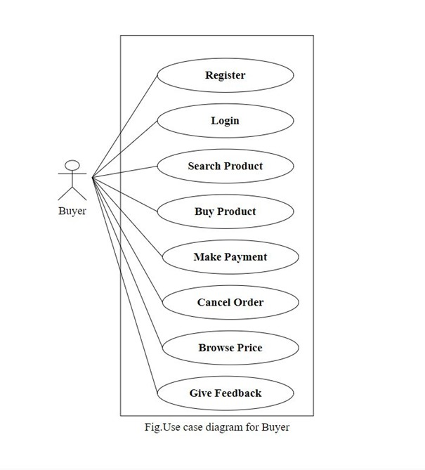
3.Buyers

Slide 10
Limitations
Product Quality and Freshness-Dairy products, such as milk and cheese, have a limited shelf life. Ensuring their freshness during delivery can be a challenge, especially for products that require refrigeration.
Limited Product: Variety Limited Product Range: Offering a wide variety of dairy products online can be challenging due to limitations in storage, handling, and transportation capabilities. Online retailers might need to prioritize certain products over others, potentially leading to limited options for customers.
Geographical Limitations: Delivery of dairy products might be restricted to certain geographic areas due to the need for quick and efficient transportation to maintain freshness.

Slide 11
Future Scope
Expansion of Product Range: As the website gains popularity and consumer trust, you can consider expanding the range of dairy products offered, including specialty and organic options.
Personalized Recommendations: Implementing AI-driven algorithms can provide personalized product recommendations based on user preferences and purchase history, enhancing the user experience.
Subscription Models: Introducing subscription plans for regular dairy deliveries can create a loyal customer base and ensure a steady revenue stream.
Payment Gateway: Providing real time transaction in website.

Slide 12
Conclusion
Customers can seamlessly browse through products and place order.
Customers can select many variety of products to cart such as milk ,cheese, ghee, yogurt, butter and more of various brands .
Online dairy world website bridge the gap between suppliers and buyers in digital way.

Slide 13
Thank You

